Slide 1
Building web front ends for desktop and mobile using the latest web standards
[Speaker]
[Company]
Email: [Email]
Twitter: [Twitter]

Slide 2
Agenda
Modern web standards overview
Introducing Microsoft Edge
JavaScript Libraries and Tools
Single Page Applications

Slide 3
Modern Web Standards
HTML5 + CSS3 = Magic!

Slide 4
HTML5

Slide 5


What is HTML5?
Umbrella term: vNext HTML, CSS, ECMAScript
Not a marketing message
A new standard for
a new web
A language with support on a variety of devices

Slide 6
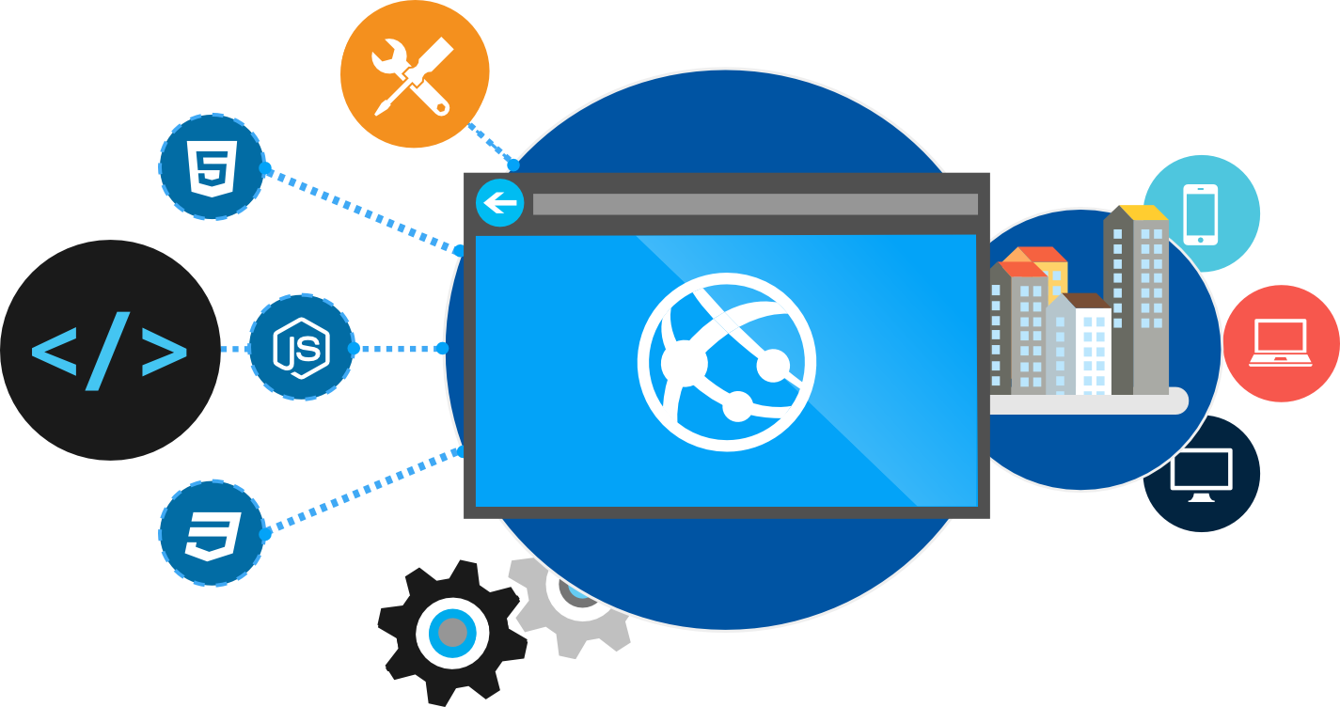
Why do you care?
Browsers have become really powerful
Standards mean you can target features, not browsers

Slide 7
HTML5 examples: Photosynth 2 Hover contre jour
demo…

Slide 8
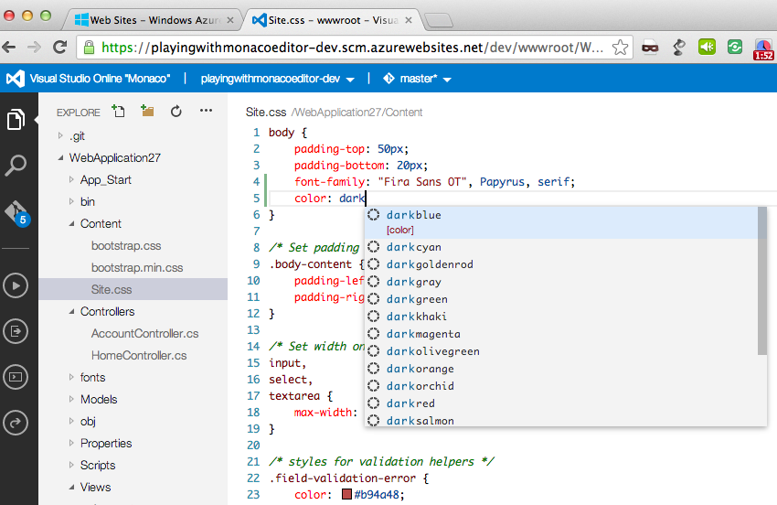
Visual Studio Online

Slide 9
Map of Web Browser Standards
HTML
CSS
Web Apps
SVG
Geolocation
ECMA Script 262
Standard
W3C
ECMA
Standards
Body

Slide 10
ECMAScript 262 APIs
Geolocation API
Basic Shapes
DOM L2 Style
Web SQL Database
CSS Text
Filters
Document Structure
DOM L2 Events
Web DOM Core
CSS Cascading And Inheritance
HTML5 Diff From HTML4
Fonts
DOM L3 Abstract Schemas
DOM L2 Views
Uniform Messaging Policy
CSS Values And Units
CSS Writing Modes
HTML5 Markup
DOM L2 Core
Server-sent Events
CSS Speech
Smil
DOM L3 Views And Formatting
Element Traversal
CSS Color
CSS Print Profile
Html+rdfa
Dom L1
Selectors API L2
CSS Media Queries
Gradients And Patterns
DOM L3 Xpath
Cors
CSS Paged Media
Microdata
Xmlhttprequest L2
Selectors API
CSS Template Layout
Styling
DOM L3 Validation
CSS Animations
CSS Namespaces
Canvas 2D Context
Xmlhttprequest
Progress Events
CSS Multi-column Layout
Scripting
DOM L3 Load And Save
CSS Transitions
CSS Snapshot 2007
Html5
Web Workers
CSS Basic Box Model
Painting, Filling, Color
DOM L3 Events
CSS 3D Transformations
Text Alternatives
Web Storage
CSS Fonts
Transforms
DOM L3 Core
Programmable HTTP Caching And Serving
CSS 2D Transformations
Polyglot Markup
Web Sockets API
Index DB
CSS Backgrounds And Borders
Text
Dom L2 Html
CSS Image Values
Paths
DOM L2 Traversal And Range
Web IDL
File API
CSS Generated Content For Paged Media
CSS Flexible Box Layout
CSS Grid Positioning
CSS Line Grid
CSS Ruby
CSS Scoping
CSS Basic User Interface

Slide 11
Building with standards
Modern.ie
Can I Use
Compat Inspector
Modernizer
CSS Resets (Normalize.css)

Slide 12
New HTML5 Markup Elements
From this:
<div class=“header”></div>
<div class=“nav”></div>
To this:
<header></header>
<nav></nav>

Slide 13
New HTML5 Markup Elements
Eliminate the “generic” tagging
Native tags DOM parsing is quicker than class searching
Accessibility
Standardizing tags
Why?

Slide 14
Bootstrap

Slide 15
Bootstrap – Why use it?
CSS is can be tricky
Cross browser support can be a challenge
Solves basic tasks (e.g. page layout without tables)
Bootstrap 3 makes it easier

Slide 16
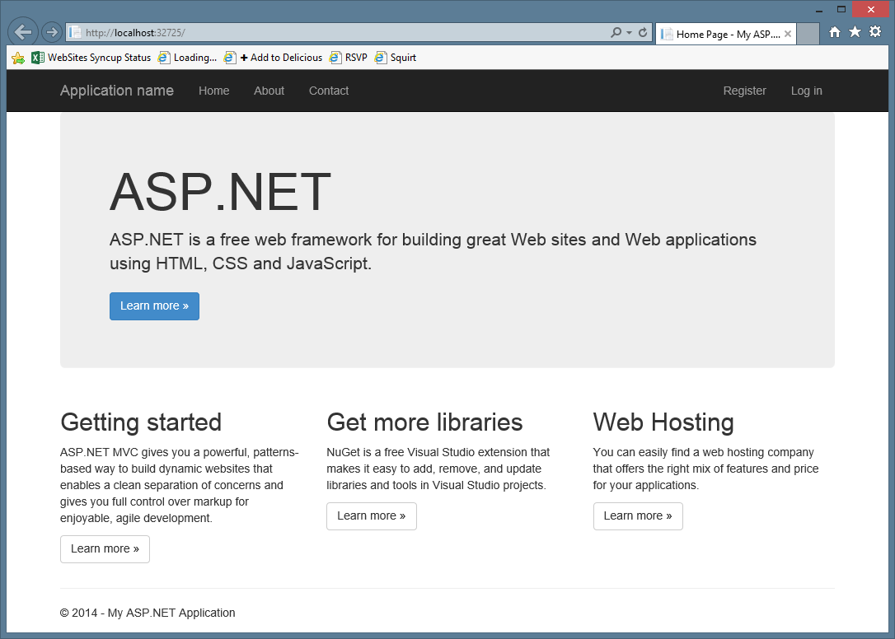
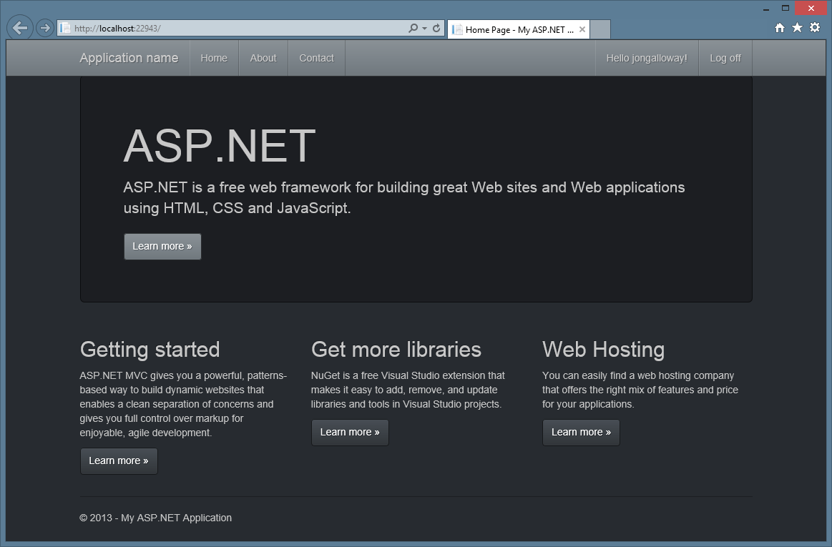
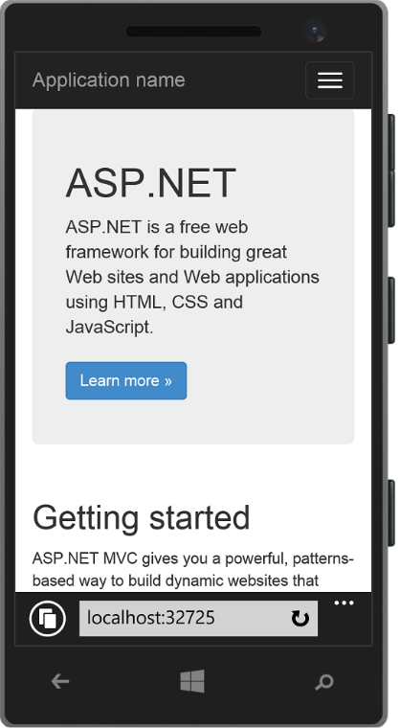
Bootstrap Features
Theme Support
Responsive
Grid system
Components
Pagination
Buttons
Modal
Great Visual Studio support

Slide 17
Bootstrap Grid system
Bootstrap works on a grid
The grid has 12 columns
There are four grids
One grid for each screen size
Large (1200px and higher)
Medium (992px-1200px)
Small (768px-991px)
Extra small (less than 768px)

Slide 18
Bootstrap Grid system
 | Extra small devices Phones (<768px) | Small devices Tablets (≥768px) | Medium devices Desktops (≥992px) |  | Large devices Desktops (≥1200px)
Grid behavior | Horizontal at all times | Collapsed to start, horizontal above breakpoints
Container width | None (auto) | 750px |  | 970px |  | 1170px
Class prefix | .col-xs- | .col-sm- |  | .col-md- |  | .col-lg-
# of columns | 12
Column width | Auto | 60px |  | 78px |  | 95px
Gutter width | 30px (15px on each side of a column)
Always 12 columns

Slide 19





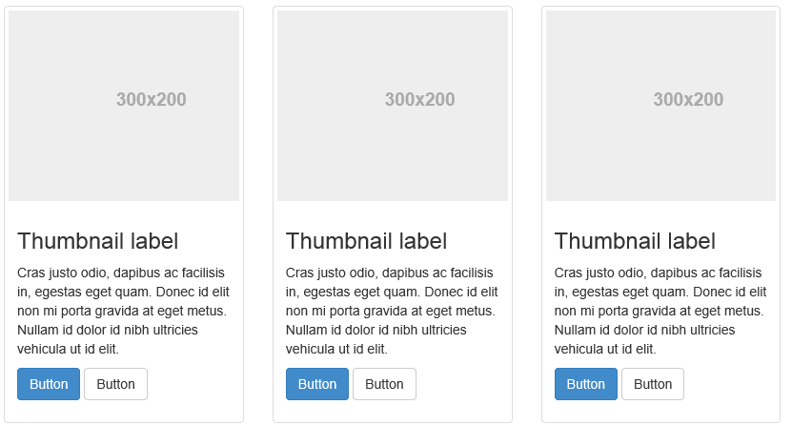
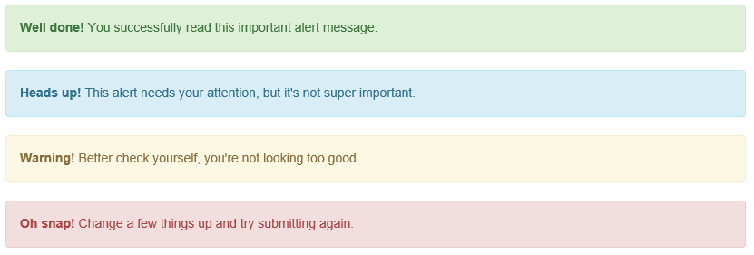
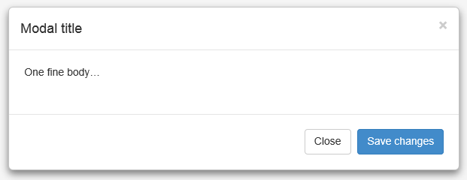
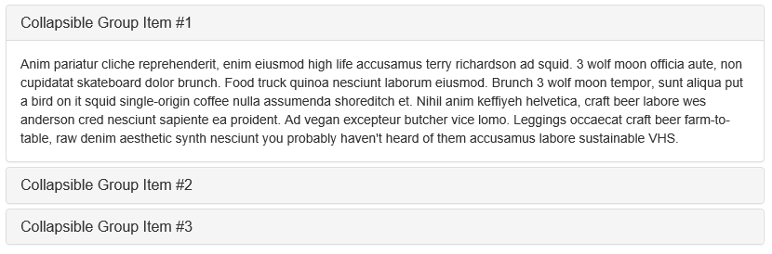
Bootstrap components

Slide 20
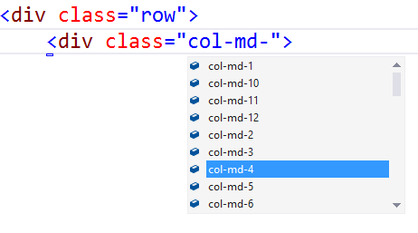
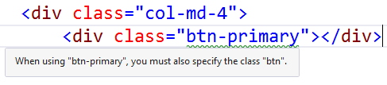
Bootstrap - Visual Studio support
CSS Class IntelliSense
Updated templates and MVC scaffolding to use Bootstrap classes
Web Essentials - Missing class detection

Slide 21
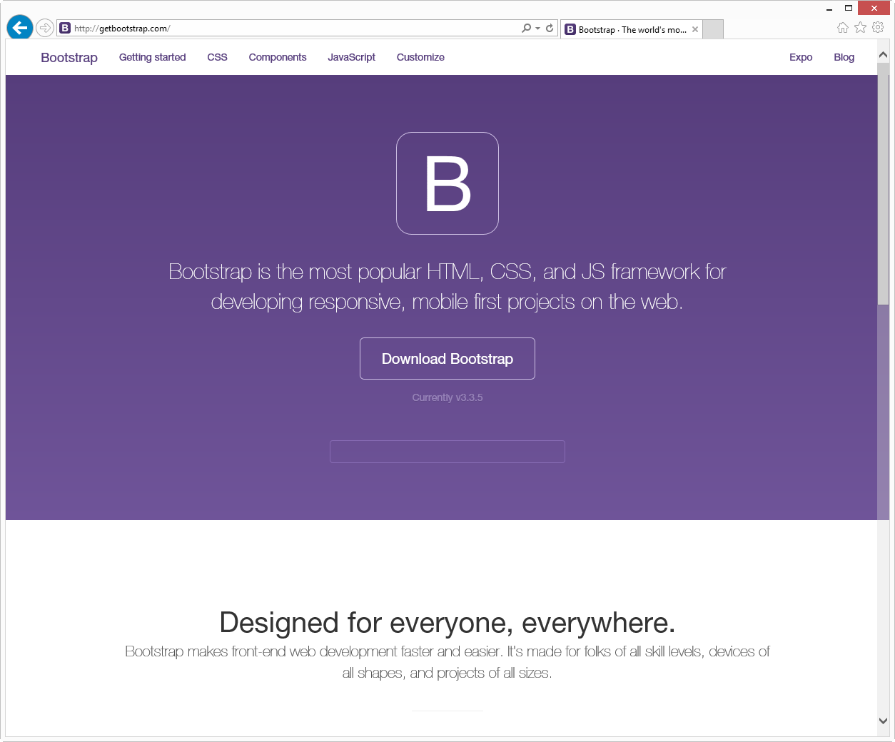
http://getbootstrap.com/

Slide 22
Demo
HTML5 in ASP.NET Templates
Notes:
Distill the HTML5 Markup Concept
+Overview HTML5 Project Template
- New Semantic Tags
- Bootstrap Overview (CSS Reset, etc)

Slide 23
Introducing Microsoft Edge
The browser for doing

Slide 24




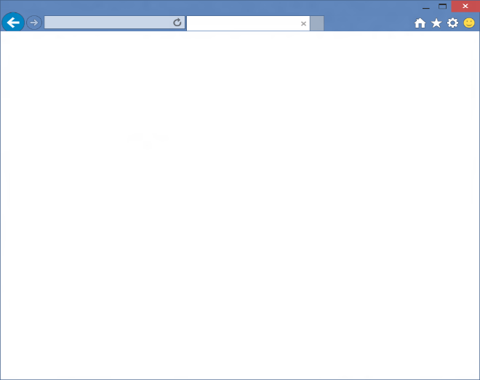
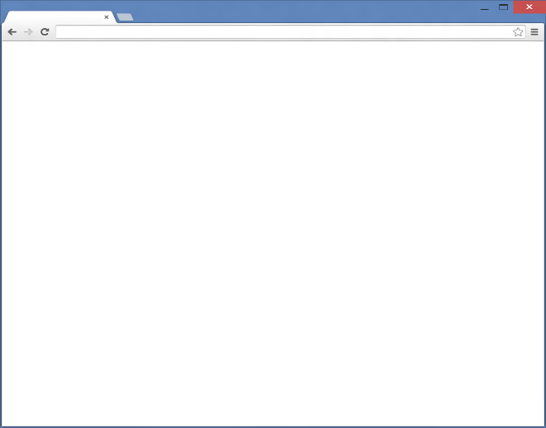
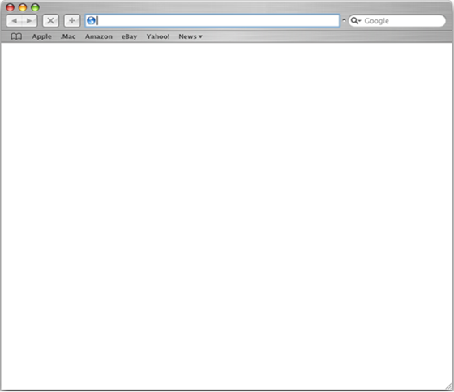
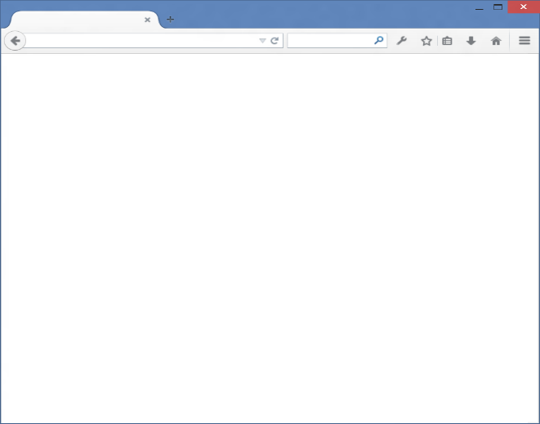
Rendering engines overview
Browser
Internet Explorer
Browser
Chrome
Browser
Safari
Browser
Firefox
Web Platform
Trident
Web Platform
Blink
Web Platform
Webkit
Web Platform
Gecko

Slide 25
Microsoft EdgeHTML rendering engine
Today, multiple code paths need to be maintained
With new engine built to be interoperable with modern standards
Incoming browser request
Incoming browser request
Legacy standards
Modern standards
Which browser?
Multiple IE code paths
Webkit, Blink & Gecko code
EdgeHTML Webkit, Blink & Gecko code

Slide 26

Modern Web
HTML5, SVG, ES5, CSS3
Legacy Web
CSS2.1
HTML4, ES3, CSS2
1995
2015
1
2
3
4
4.x
5
5.5
6
7
8
9
9
10
11
Compatibility Engine mshtml.dll
Silverlight
Java
Flash
BHOs
ActiveX
IE5
Quirks
IE7
Compat View
IE8
Standards Mode
EMIE
Enterprise Mode
Internal engine switch enabled by CV lists, x-ua-compatible and meta tags
For sites requiring ActiveX or BHO
IE9
Standards Mode
IE10
Standards Mode
QME
Quirks Mode Emulation
IE11
Standards Mode
BHO
ActiveX

Slide 27

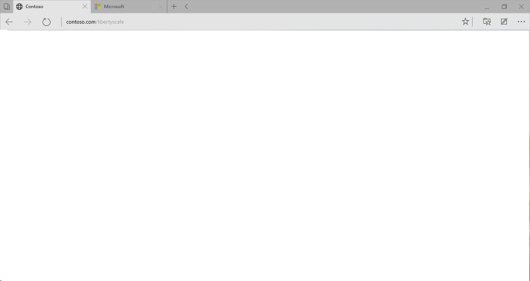
Microsoft Edge is evergreen browser
Browser
Microsoft Edge
Browser
Chrome
Browser
Firefox
Blink
Gecko
Microsoft EdgeHTML
Evergreen
Evergreen
Evergreen
Notes:
Explain that Web developers can expect Project Spartan’s new engine to be interoperable with the modern Web and remain “evergreen” (auto-updates on a regular cadence), with no document modes or compatibility views introduced going forward.
The need for legacy document modes is primarily limited to Enterprise legacy web apps, to guarantee a much higher level of compatibility for customers who depend on those modes. See http://blogs.msdn.com/b/ie/archive/2014/11/11/living-on-the-edge-our-next-step-in-interoperability.aspx

Slide 28
Legacy compatibility
Microsoft Edge is designed for the modern web and does not support IE legacy extensibility points
Internet Explorer on Windows 10 will continue to support these extension points for enterprise compatibility.
If Microsoft Edge runs into content that requires legacy IE functionality that is no longer supported, it will launch IE for that site
IE11 on Windows 10 will continue to support Enterprise Mode for high fidelity IE8 emulation
IE11 on Windows 10 has full parity with IE11 on Windows 7/8.x for compatibility
Eases transition to Window 10 for some enterprises with legacy web app needs.
Notes:
Explain that IE with Enterprise Mode provides high fidelity backwards compatibility for LOB apps

Slide 29

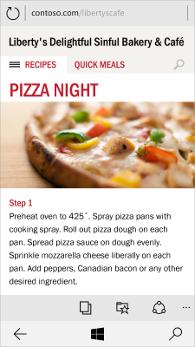

Modern web interoperability
New engine with focus on interoperability with modern browsers and new HTML5 functionality
Sites authored for Firefox, Chrome and Safari “just work” with Microsoft Edge
Over 4200 interoperability fixes, and 45+ new features to render it correctly
m.macys.com
Windows Phone 8.1
Windows Phone 8.1 + GDR1: With support for –webkit-gradient
Notes:
Talking points Our goal is “the web just works”
Use standards as a reference but prioritize real-world interop (and then fix standards if needed)
Allow web developers to target a single version
Internet sites use the new rendering engine (EdgeHTML) by default
New update cadence to ensure browser is always up-to-date
Make a clean break from the past
Interoperable user-agent string to get the same content as other browsers (no IE specific code)
Over 4200 interoperability fixes, and 45+ new features to render it correctly
Remove IE specific behaviors

Slide 30
Interoperable UA string
Interoperability Trident (EdgeHTML)
Mozilla/5.0 (Windows NT 10.0; WOW64) AppleWebKit/537.36 (KHTML, like Gecko) Chrome/39.0.2171.71 Safari/537.36 Edge/12.0
Chrome
Mozilla/5.0 (Windows NT 10.0; WOW64) AppleWebKit/537.36 (KHTML, like Gecko) Chrome/39.0.2171.95 Safari/537.36
Notes:
Explain that the user-agent was changed in Microsoft Edge to get the same content/behaviors as other browsers (no IE specific code)

Slide 31
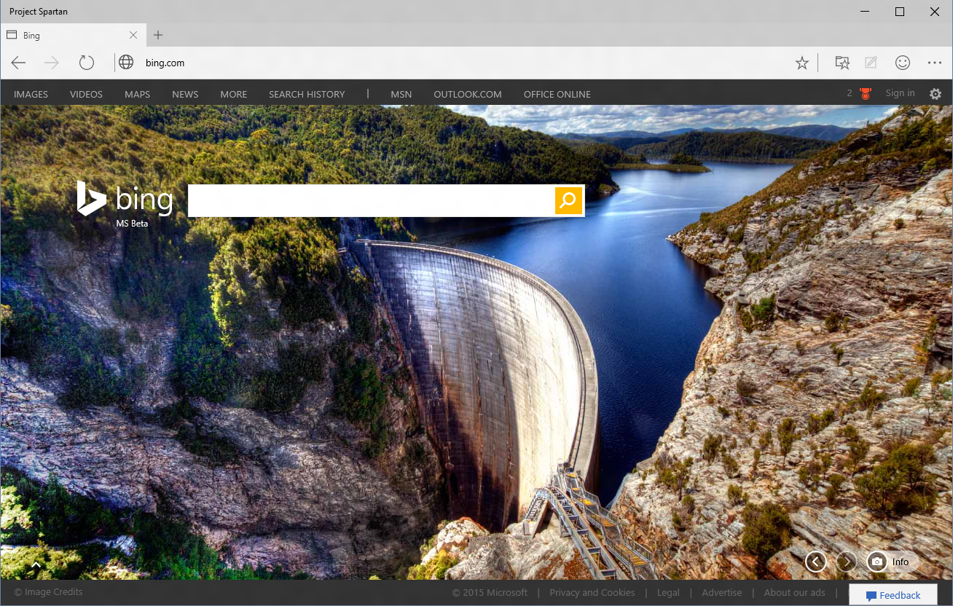
Securing Microsoft Edge
Multi-process architecture
- MS Edge frame itself runs in App Container
- Tabs run in EPM
Extensibility
- Constrained ActiveX controls
- No Toolbars or BHOs
Rigorous Memory Protection
Reduced Attack Surface
SmartScreen Getting Smarter
Microsoft Edge
Security Investments
App Container
64bit Protections
Windows
Platform
Notes:
Microsoft Edge is a modern Windows App, taking full advantages of the platform protections offered by App Container.
Even if MS Edge is compromised, the platform prevents malicious code from escaping the sandbox.
IE Classic in contrast, runs the frame process at MediumIL
EPM: Tabs run in separate processes also protected by app container
By default ActiveX will be limited to a small list of known good ActiveX controls beyond Flash, which remains built in.
Toolbars and BHOs, a common source of security and performance problems will simply not load in Microsoft Edge
See http://blogs.windows.com/msedgedev/2015/05/11/microsoft-edge-building-a-safer-browser/
In IE 11 over the last several months we have introduced memory protections that have eliminated broad sets of security threats
IsoHeap and Memory Protector have proven valuable.
http://securityintelligence.com/understanding-ies-new-exploit-mitigations-the-memory-protector-and-the-isolated-heap/#.VMrz-P50wuU
We are continuing to invest in stopping exploits where they start – by preventing memory from being abused by an attacker
These protections will appear in Windows 10/Microsoft Edge first and will be backported as makes sense.
64bit by default also makes it very hard to attack memory via a heapspray or by breaking ALSR
Microsoft Edge is a complete re-write of the Browser, allowing us to deprecate a significant amount of code, and legacy interfaces that are no longer present to be attacked
We are working to make SmartScreen even smarter – currently protects users from Phishing and malicious downloads, in the future will also project you from malicious sites.

Slide 32
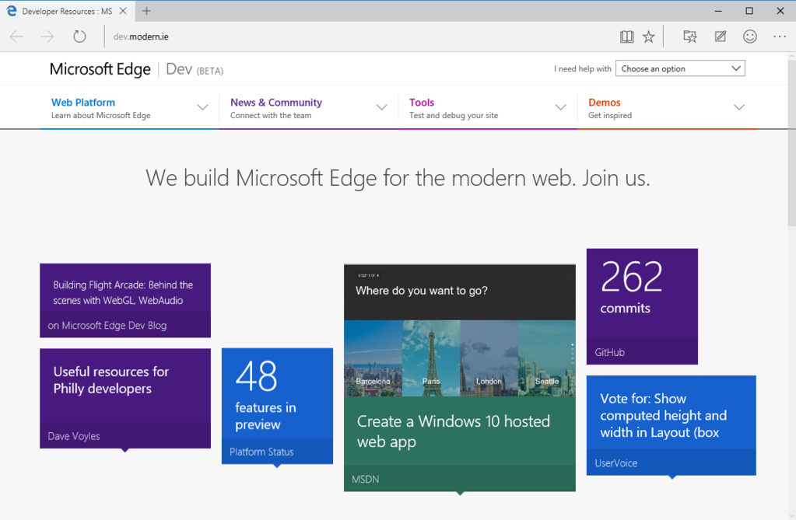
http://dev.modern.ie/

Slide 33
JavaScript Libraries and Tools
Overview

Slide 34
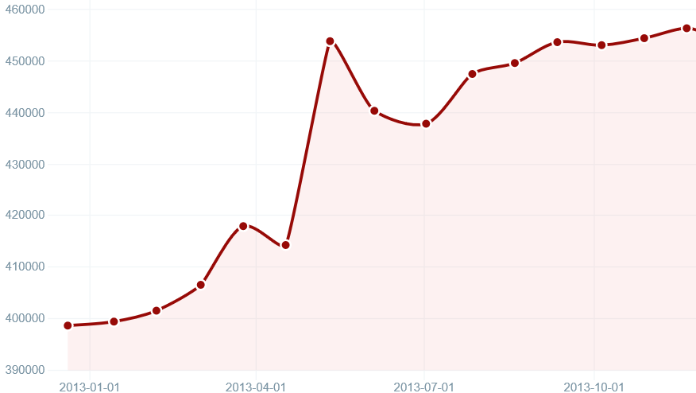
Who Uses jQuery?
Over 59 million sites
66.2% of the top 10k
Source: http://trends.builtwith.com/javascript/jQuery

Slide 35

jQuery – why so popular?
Easy to learn
Loads of Plugins
Powerful DOM Selection
Lightweight
Community Support

Slide 36
jQuery Community
jquery.com
api.jquery.com
forum.jquery.com
meetups.jquery.com
plugins.jquery.com
jqueryui.com
Downloading
Documentation
Community
Local Community
Extending
UI Widgets and Effects

Slide 37
jQuery Fundamentals
Find something, Do something
Functional Syntax
DOM Manipulation
Changing of events
<script>
$(function() {
$('.submit').click( function(){
$('.submit').css('color', '#ff0000');
$('#container')
.append($('<span>Clicked!</span>')
.click(function(){ alert('foo'); }));
});
});
</script>
<script>
$(‘div’).hide();
</script>
<div>This will be hidden</div>
<div>So will this</div>
<div>Even this</div>
<script>
$(function() {
$('.submit').click(function(){
alert('post form');
});
});
</script>
<input class=“submit” type=“button” value=“Submit”/>
<script>
$(function() {
$('.submit').click(function(){
alert('post form');
});
});
</script>
<input class=“submit” type=“button” value=“Submit”/>

Slide 38
Demo
jQuery
Notes:
http://jsbin.com/ijucaq/2/edit

Slide 39
JavaScript Tools

Slide 40
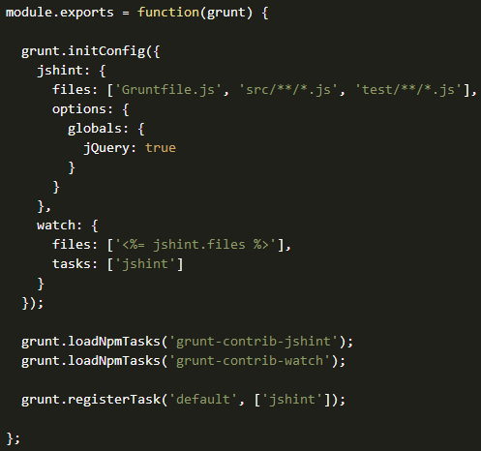

Grunt
JavaScript Task Runner
Automates minification, unit testing, compilation, etc.
Configuration over code
Common tasks already available as Grunt Plugins

Slide 41
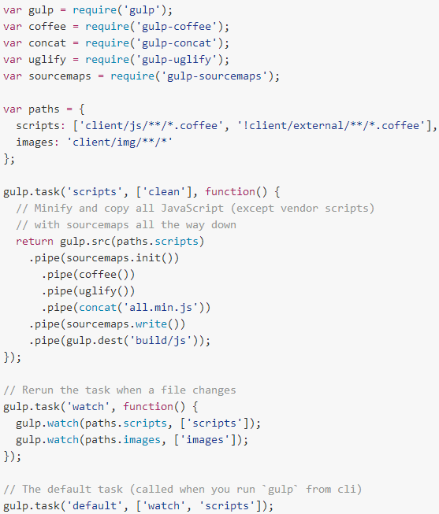

Gulp
Another JS Task Runner
Code over config
Streaming build system
Tasks are executed in maximum concurrency

Slide 42
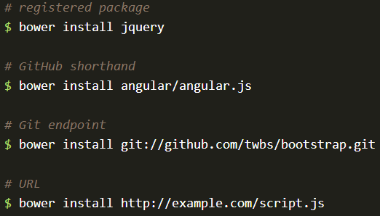

Bower
The package manager for the Web
50k existing users
>25k packages
Notes:
See http://bower.io/stats/

Slide 43
Single Page Applications
Overview and frameworks

Slide 44
Comparison: standard page requests
Client Browser
Request: http://site.com/products/
Web Server
HTML
CSS
Images
Javascript
Response: Full page
Request: http://site.com/products/6
Response: Full page
HTML
CSS
Images
Javascript

Slide 45
Comparison: Single Page Application
Client Browser
Request: http://site.com/products/
Web Server
HTML
CSS
Images
Javascript
Response: Full page
Request: http://site.com/products/6
Response: Tiny bit of data
{product}

Slide 46
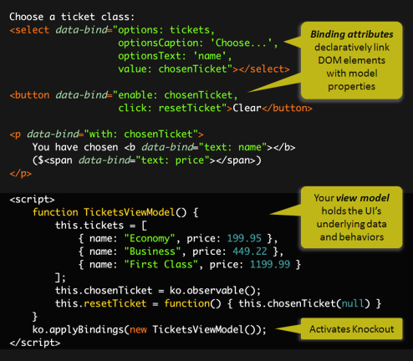
Knockout.js
Declarative Bindings
Automatic UI refresh
Dependency Tracking
Templating

Slide 47

AngularJS
<!doctype html>
<html ng-app="app">
<body>
<tabs>
<pane title="Localization">
Date: {{ '2013-04-01' | date:'fullDate' }} <br>
Currency: {{ 123456 | currency }} <br>
Number: {{ 98765.4321 | number }} <br>
</pane>
<pane title="Pluralization">
<div ng-controller="BeerCounter">
<div ng-repeat="beerCount in beers">
<ng-pluralize
count="beerCount“
when="beerForms">
</ng-pluralize>
</div>
</div>
</pane>
</tabs>
</body>
</html>
Custom Tag Attributes
Powerful Directives
Declarative Style
Strict Separation

Slide 48
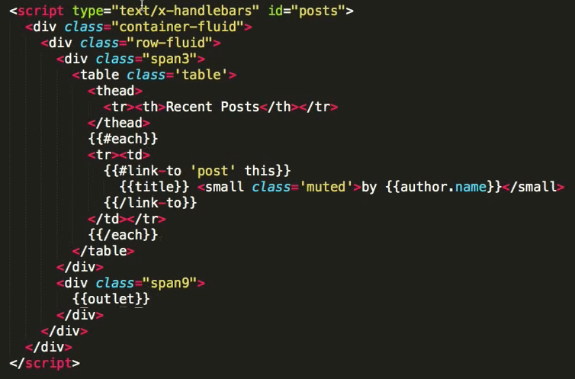

Ember.js
Ember is a framework
Convention over config
URLs are important

Slide 49
Demo
Building the GeekQuiz front end

Slide 50
Summary
Modern web standards overview
Microsoft Edge
JavaScript Libraries and Tools overview
Single Page Applications

Slide 52
Canvas
A block element that allows developers to draw 2d graphics using JavaScript
Methods for drawing include: paths, boxes, circles, text and rasterized images
<canvas id="myCanvas" width="200" height="200">
Your browser doesn’t support Canvas, sorry.
</canvas>
<script type="text/javascript">
var example = document.getElementById("myCanvas");
var context = example.getContext("2d");
context.fillStyle = "rgb(255,0,0)";
context.fillRect(30, 30, 50, 50);
</script>

Slide 53
HTML 5 <video>
Support for the HTML5 <video> element
Industry-standard MPEG-4/H.264 video
Video can be composited with anything else on the page
HTML content, images, SVG graphics
Hardware accelerated, GPU-based decoding

Slide 54
HTML 5 <video> Attributes
src – specifies the location to pull the source file
autoplay – if present starts playing as soon as it’s ready
controls – if present displays controls
preload – if present loads source at page load
loop – if present loops back to the beginning of the video
<video src="video.mp4" id="videoTag">
<!-- Only shown when browser doesn’t support video -->
<!-- You Could Embed Flash or Silverlight Video Here -->
</video>

Slide 55
Multiple HTML 5 <video> Sources?
source – child element used to specify the location to pull the source file(s)
<video poster="video.jpg">
<source src="video.mp4"/>
<source src="video.ogv"/>
<p>This is fallback content</p>
</video>

Slide 56
HTML 5 <audio>
Industry-standard MP3 and AAC audio
Fully scriptable via the DOM
Attributes
src – specifies the location to pull the source file
autoplay – if present starts playing as soon as it’s ready
controls – if present displays controls
preload – if present loads source at page load
<audio src="audio.mp3" id="audioTag" autoplay controls>
<!-- Only shown when browser doesn’t support audio -->
<!-- You could embed Flash or Silverlight audio here -->
</audio>

